Slide 1

Overview of Automatic Generation Control For a Single Area Topology

Slide 2
Automatic Generation Control (AGC):
Power Systems that generate electrical energy from rotational devices such as turbines have a frequency parameter which controls the power interchange within the system. The objective of the AGC application is to ensure a stable pre-defined system frequency and supply energy among the system within a desired level.

Slide 3
The frequency control of electrical power systems is categorized in two classification-
Primary Control
Secondary Control

Slide 4
Primary control
The primary frequency control is an instant control scheme integrated with the turbine itself. It is independent of the load demand of the overall system. Primary controller is designed to compensate for the sudden change in the turbine output frequency immediately (normally 30s). Primary controller only takes in the respective turbine parameters as input and deliver response according to the individual turbine characteristics. Primary control acts to keep the system frequency within a stable frequency level from where the secondary control can cover up the frequency and power imbalance.

Slide 5
Secondary control
After primary control is initiated the system frequency level comes to a specific point defined by the controller. But this value is different from the nominal value and power exchange among the network is also not as planned. So, the secondary control is activated to mitigate the frequency imbalance and power exchange of the overall system. Secondary control considers the overall system parameters such as load demand and power exchange in tie lines. Usually, the secondary control acquires data from a central system monitoring unit and provides system response considering the entire power network’s state.

Slide 6
Why do we need agc?
Keep stable frequency in an interconnected energy network.
Balance the power generation and grid consumption in the network.
Maintain scheduled level of power flow in the tie lines.

Slide 7
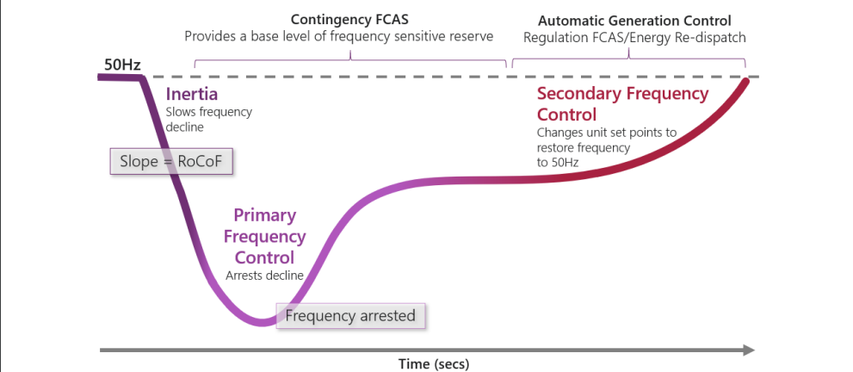
Frequency control response

Slide 8
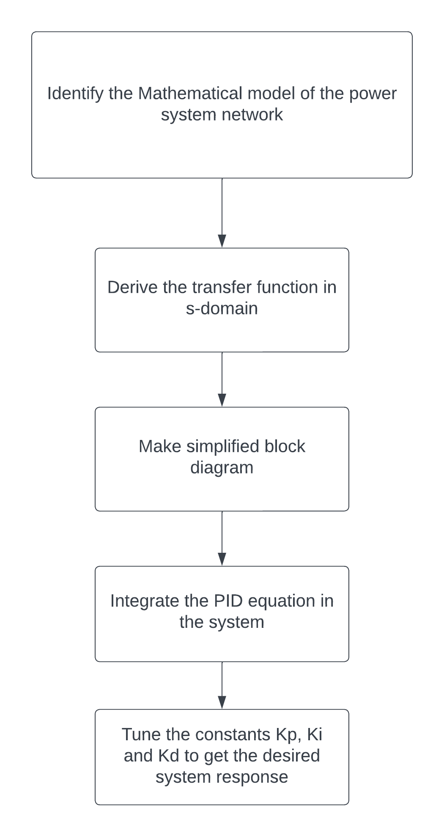
Steps of implementing agc

Slide 9
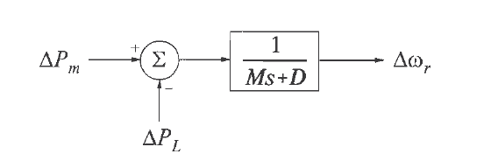
Mathematical model
System frequency response of an alternator to a load change is determined by its moment of inertia and load constant. The simplified block diagram is described here.
ΔP_m = Mechanical power (MW)
ΔP_L = Step load change (MW)
M = 2*H (MW-sec/MVA) [H = Moment of Inertia of alternator]
D = Load damping constant

Slide 10
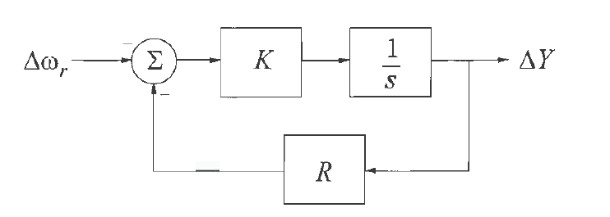
Control mechanism
For steam turbines, steam turbine governing adjusts the mechanical output of the turbine by increasing or decreasing the amount of steam entering the turbine via a throttle valve.
The PID controller adjusts the amount of opening or closing of the steam valve.
The droop characteristic of the alternator in the feedback loop determines the ACE value (Area Control Error) and the PID controller acts to minimize this error value.

Slide 11
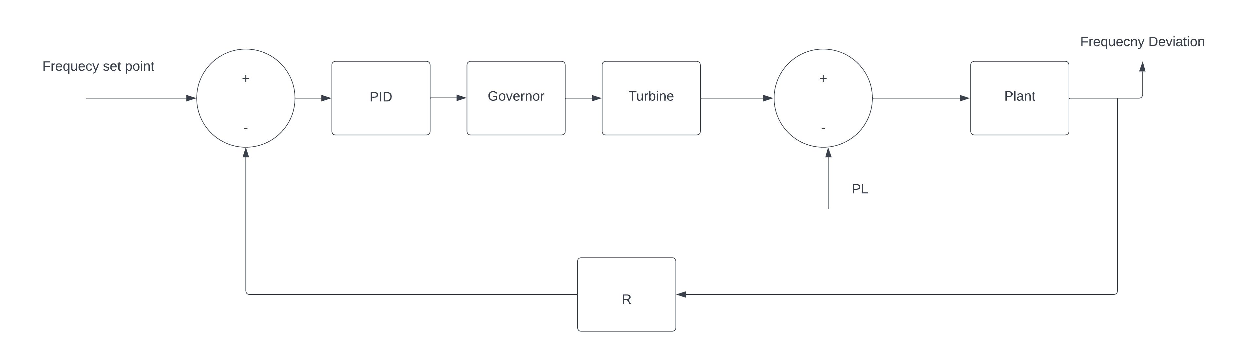
Block diagram of the overall system
An alternator consisting of governor and turbine integrated with a PID controller and a closed loop feedback gain can be expressed as the below simplified diagram:

Slide 12
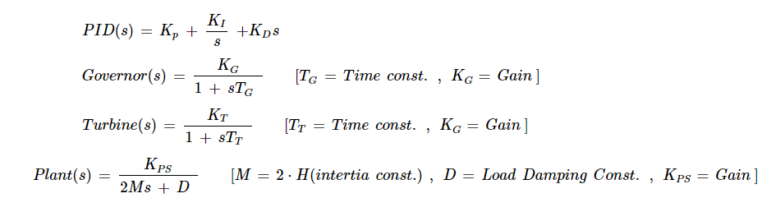
Transfer functions of the blocks

